Slide 1






Energy Consumption Data Analysis
Presented By
Manar Sabri

Slide 2




Table of Content
1
Introduction to the dataset and key variables
2
Data cleaning and preprocessing
3
Feature Engineering | Data Transformation
4
Visualizing energy consumption patterns
5
Statistical Hypothesis Testing and Cost Optimization

Slide 3





Welcome! We’ll explore valuable insights from an extensive dataset of energy consumption data collected from network sites.
01

Slide 4


Introduction
This project focuses on analyzing energy consumption data collected from network sites. The primary goal is to monitor and track energy usage to identify patterns and actionable insights. By leveraging statistical analysis and data visualization techniques, the aim is to validate key assumptions and propose strategies for optimizing energy consumption. The insights derived from this analysis can support decision-making processes related to energy management and cost reduction.
02

Slide 5


Introduction to the dataset and key variables
Key Variables
Additional Metrics
Site ID: Unique identifier for each site
Region: Geographical location of the site
DateTime: Timestamp of data collection
KWH/hh (per half hour): Energy consumption in kilowatt-hours per half-hour
Demand: Power demand in kilowatts
Region_Avg_KWH: Average energy consumption per half-hour for the region
Region_Avg_Cost: Average cost per half-hour for the region
Site_Total_KWH: Total energy consumption for the site
Site_Total_Cost: Total cost of energy for the site
03

Slide 6
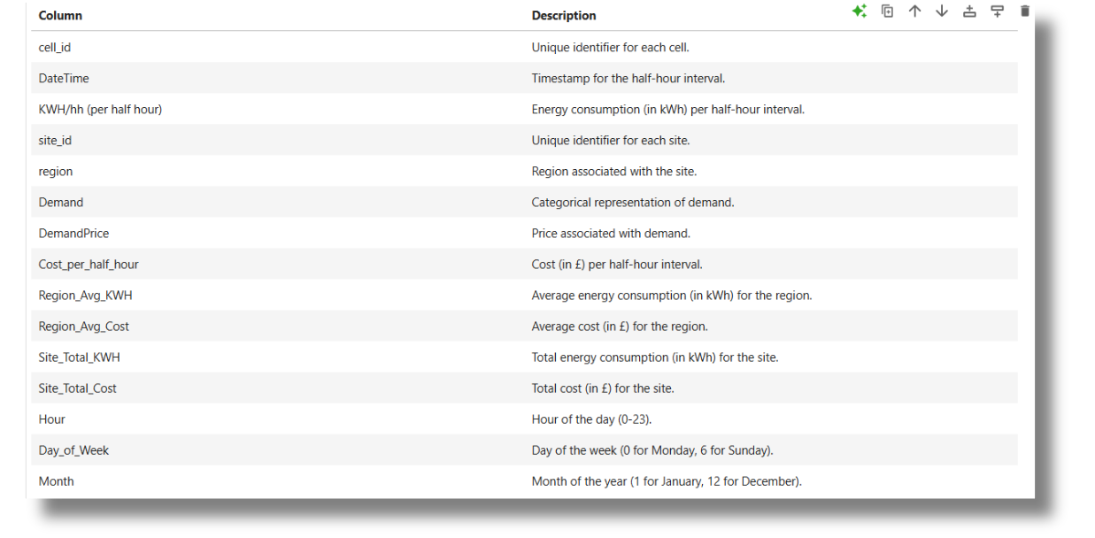
Introduction to the dataset and key variables
04

Slide 7

Data cleaning and preprocessing
1
2
3
Dataset Combination
Merged datasets (df_SE1, df_SE2, df_SE3) using vertical concatenation.
Checked and removed duplicates and missing values
Renamed DemandDateTime to DateTime in the demand dataset.
Merged combined dataset with demand data on DateTime.
Data Cleaning
Standardized time intervals.
Parsed DateTime values with error handling.
Dropped rows with invalid or missing DateTime.
Feature Engineering | Transformation
Corrected misspellings in the Demand column (e.g., 'Normall' to 'Normal').
Mapped demand levels ('High', 'Normal', 'Low') to corresponding prices.
Cost Calculation
Region and Site-Specific Metrics
Time-Based Features
Outlier Detection
05

Slide 8
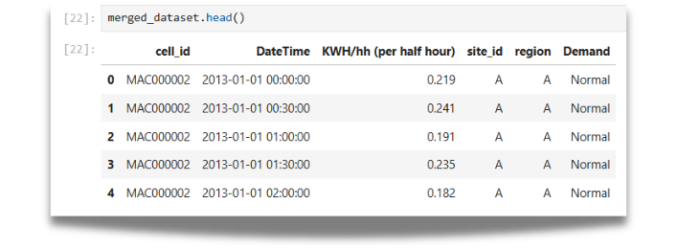
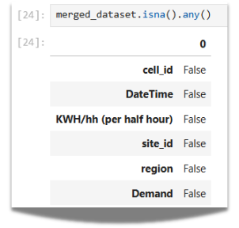
Final Merged Dataset
06

Slide 9
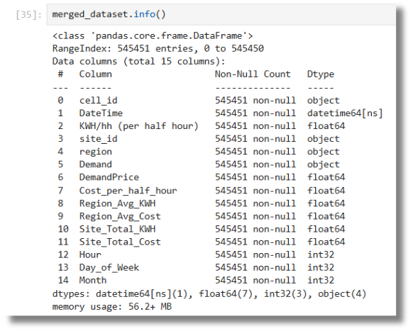
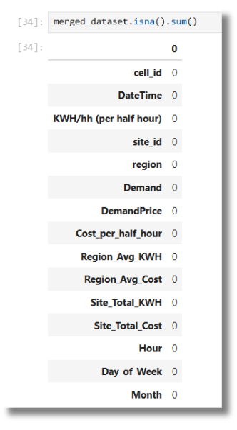

Data After Feature Engineering
07

Slide 10
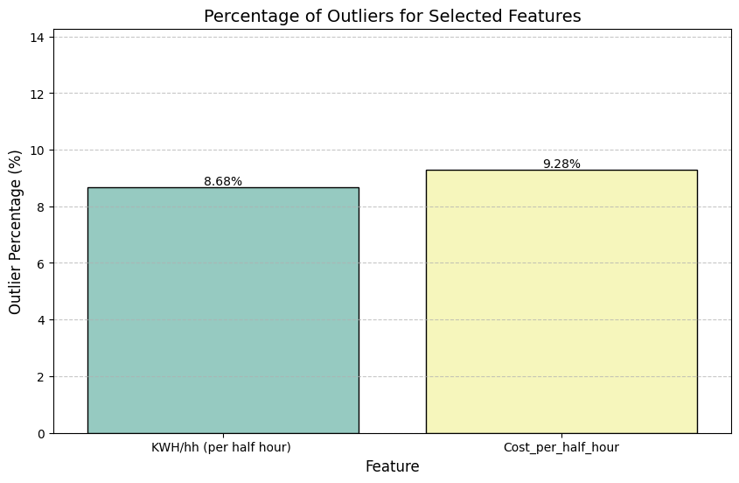
Outliers Detection
The presence of outliers in energy consumption (KWH/hh) likely impacts the cost calculations.
These outliers might indicate periods of abnormal energy usage, such as peak demands or unusual site-specific behavior.
08

Slide 11
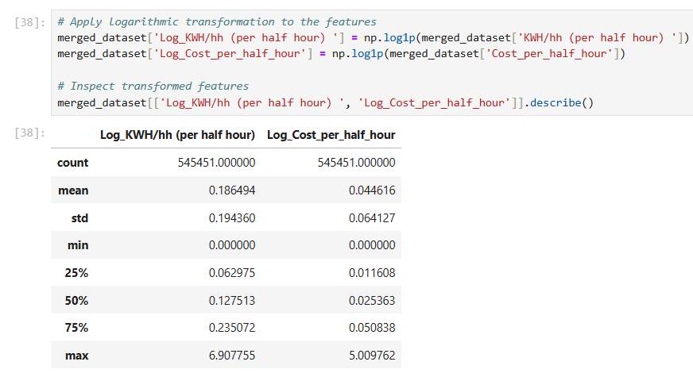
Outliers Handling
09

Slide 12

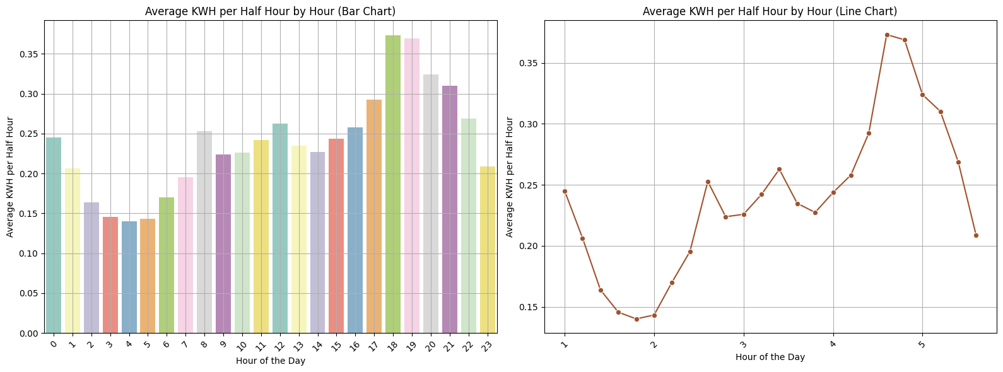

Visualizing energy consumption patterns
Hourly/Daily Aggregations
10

Slide 13
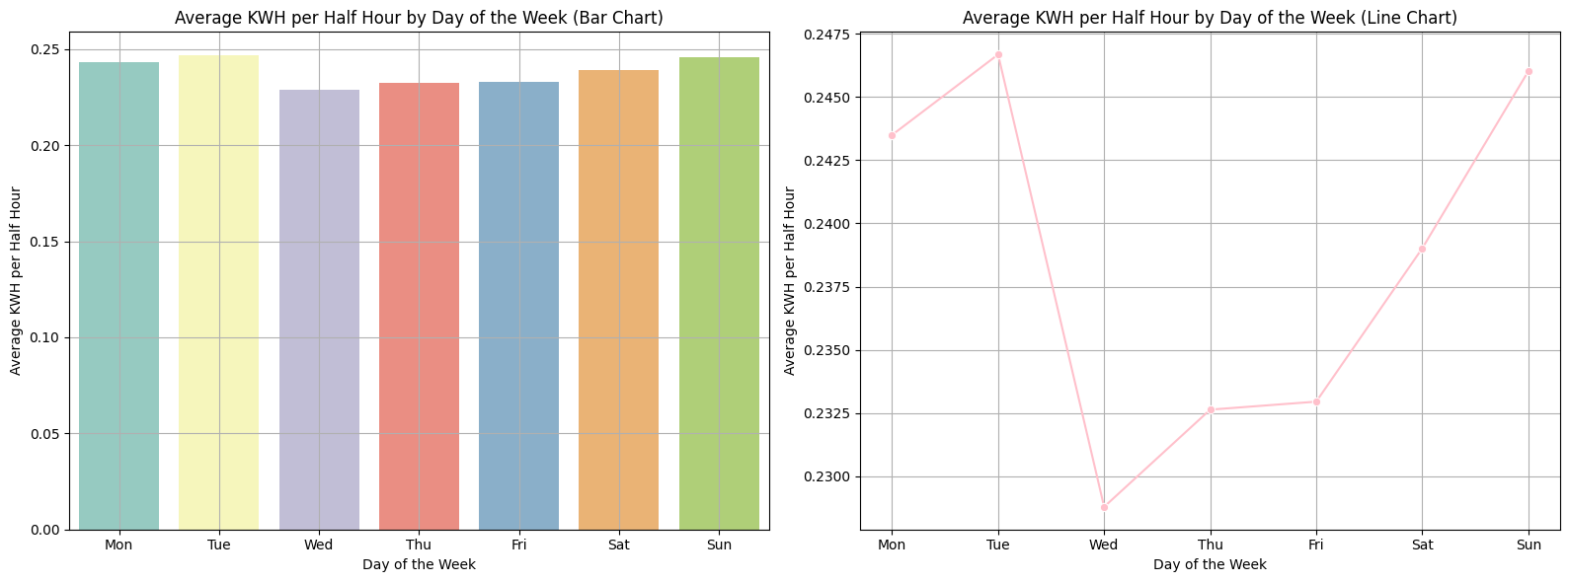
Visualizing energy consumption patterns
Hourly/Daily Aggregations
11

Slide 14
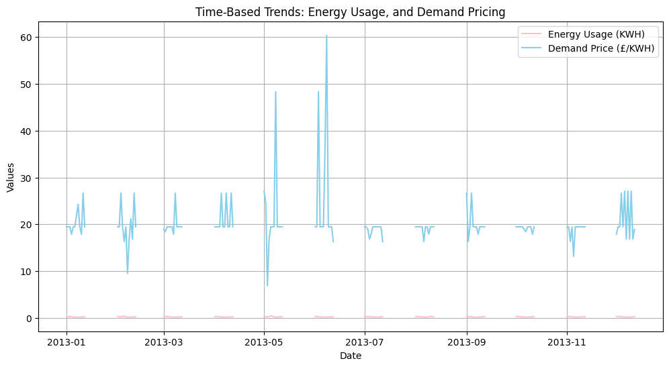
Visualizing energy consumption patterns
2. Time-Based Trends
The spikes in demand prices indicate periods of high volatility, which may coincide with supply-demand imbalances, seasonal changes, or external market factors.
Energy usage does not appear to correlate strongly with these demand price spikes, indicating other factors may drive pricing fluctuations.
12

Slide 15
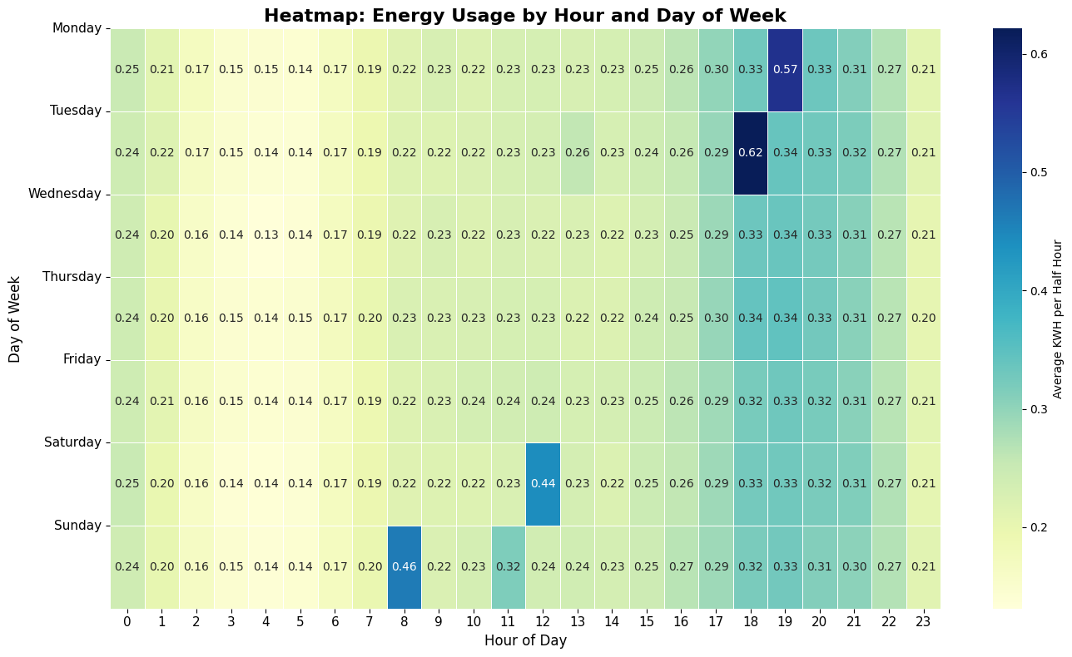
Visualizing energy consumption patterns
2. Time-Based Trends
The daily peak around 19:00 (7 PM) could be attributed to people returning home from work or school and increasing their energy usage for lighting, cooking, and entertainment.
The weekend peaks around 13:00 (1 PM) on Saturday and 12:00 (noon) on Sunday might suggest increased energy usage for daytime activities such as cooking, cleaning, or outdoor activities.
13

Slide 16
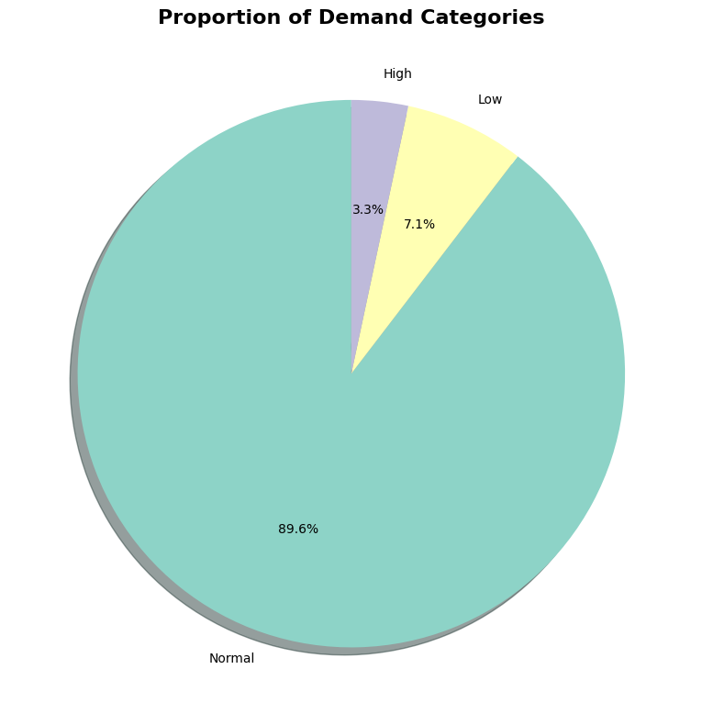
Visualizing energy consumption patterns
3. Demand and Pricing Analysis
The dominance of "Normal" demand could indicate that the system or process being measured operates within a stable and predictable range most of the time.
The presence of "Low" and "High" demand categories suggests that there are fluctuations or variations in demand that need to be considered. These fluctuations could be due to various factors such as seasonality, economic conditions, or unexpected events.
14

Slide 17
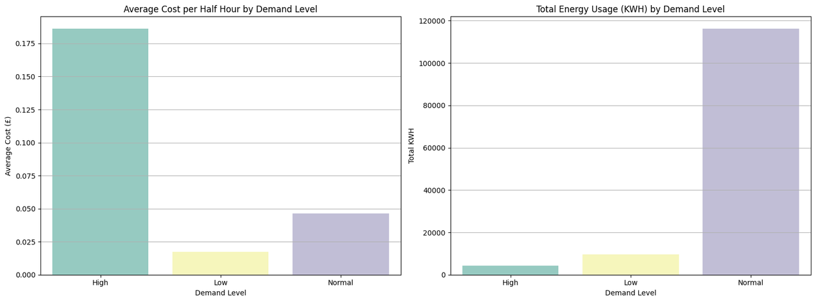
Visualizing energy consumption patterns
3. Demand and Pricing Analysis
Cost Variations: The higher cost during high demand could be due to factors such as higher energy prices during peak hours, increased strain on the grid, or the need to utilize more expensive backup power sources.
Consumption Patterns: The higher energy consumption during normal demand suggests that most activities and operations occur within this range. The lower consumption during high demand could be due to potential energy-saving measures or reduced activity levels.
15

Slide 18
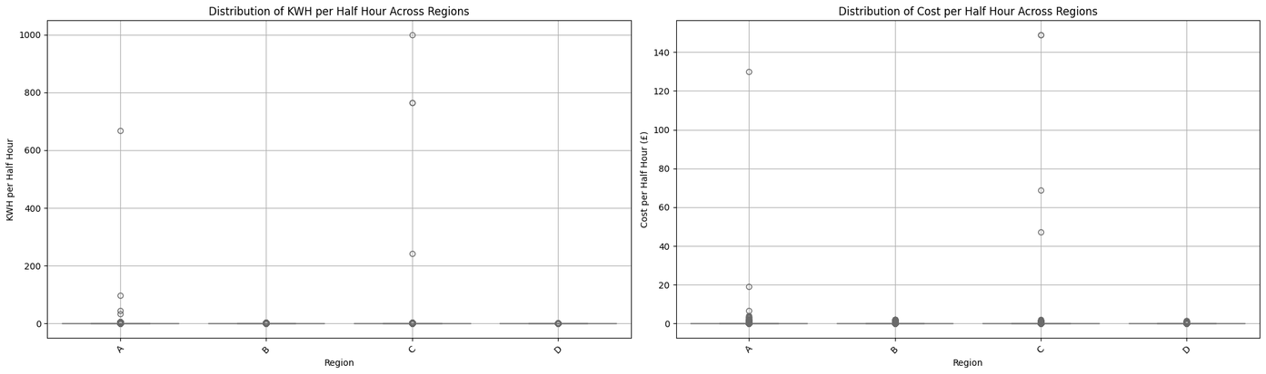
Visualizing energy consumption patterns
4. Region-Based Analysis
Industrial Activity: Regions with high energy consumption and cost could have a higher concentration of energy-intensive industries or businesses.
Population Density: Regions with higher population density might have higher energy demand due to residential and commercial activities.
Climate: Climate factors such as temperature and humidity can influence energy consumption for heating, cooling, and other purposes.
16

Slide 19
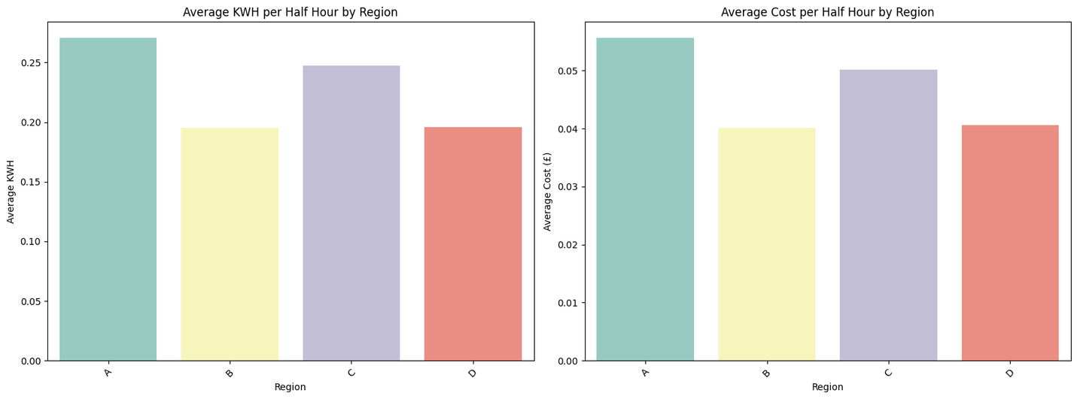
Visualizing energy consumption patterns
4. Region-Based Analysis
High KWH correlates with High Cost: Regions with higher energy consumption (KWH) tend to have higher energy costs. This relationship can be attributed to factors like peak-hour pricing, grid strain, and the need for expensive backup power.
Regional Variations: The differences in energy consumption and cost across regions are influenced by factors such as:
Population Density: Higher population density usually means higher energy demand.
Industrial Activity: Energy-intensive industries drive up energy consumption and costs.
17

Slide 20
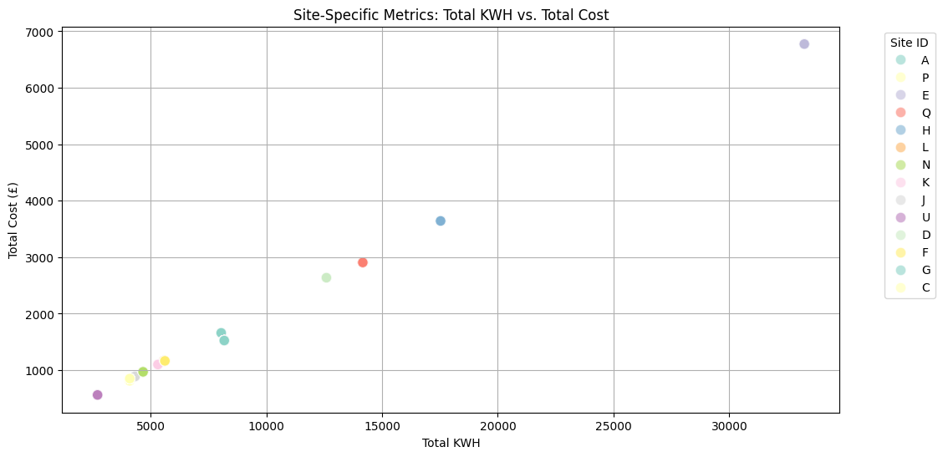
Visualizing energy consumption patterns
5. Site-Specific Metrics
Energy Pricing: Different sites might be subject to different energy pricing structures, such as time-of-use pricing or tiered pricing.
Energy Efficiency: Sites with more energy-efficient equipment or practices might consume less energy for the same level of output, resulting in lower costs.
Other Factors: Factors like energy source, energy usage patterns, and maintenance practices can also influence the relationship between KWH and cost.
18

Slide 21
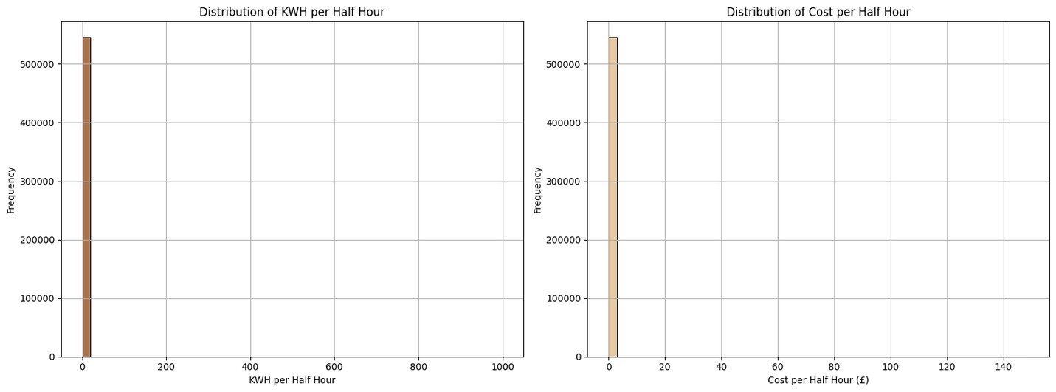
Visualizing energy consumption patterns
6. Energy Consumption Patterns
Low Energy Consumption: The high frequency of low KWH and cost values might be due to periods of low activity or demand, such as overnight hours or weekends.
Outliers: The long tails in both histograms suggest the presence of outliers. These outliers could represent periods of high energy consumption and associated costs, such as peak hours or periods of high activity.
19

Slide 22
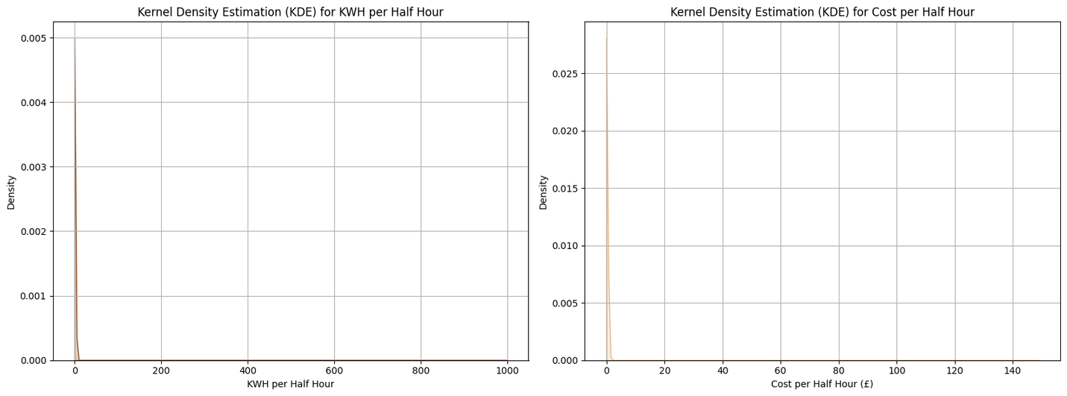
Visualizing energy consumption patterns
6. Energy Consumption Patterns
These KDE plots provide a smoother representation of the data compared to the histograms. The sharp peaks and long tails observed in the histograms are more clearly visualized in the KDE plots, providing a better understanding of the underlying probability distributions.
20

Slide 23
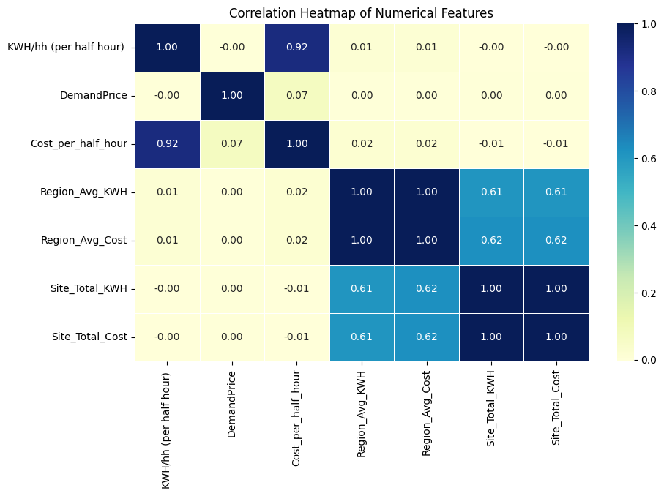
Visualizing energy consumption patterns
7. Correlations and Relationships
Energy Pricing: The strong correlation between KWH/hh and Cost_per_half_hour suggests that higher energy consumption often leads to higher costs due to factors like time-of-use pricing or tiered pricing.
Regional Variations: The strong correlation between regional averages suggests that factors like regional energy policies, infrastructure, or climate could influence both energy consumption and cost.
Site-Level Factors: The correlation between site-level totals indicates that factors specific to individual sites, such as equipment efficiency, usage patterns, and maintenance practices, can significantly impact both energy consumption and cost.
21

Slide 24


Statistical Hypothesis Testing and Cost Optimization
1. Energy Consumption by Day of the Week
We perform a One-Way ANOVA test (f_oneway) to assess if the means of energy consumption differ across weekdays. The p-value from the ANOVA test reflects the significance of this difference.
Additionally, a non-parametric Kruskal-Wallis test (kruskal) is included for robustness in case the data might not be normally distributed.
22

Slide 25
Statistical Hypothesis Testing and Cost Optimization
2. Correlation Between Demand Price and Cost
We calculate the Pearson correlation coefficient (pearsonr) to measure the linear association between DemandPrice and Cost_per_half_hour. The p-value indicates the significance of this correlation.
A Spearman correlation test (spearmanr) is included as a non-parametric alternative for potentially non-normal data.
23

Slide 26
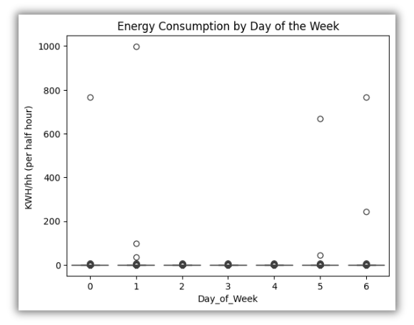
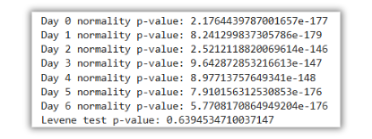

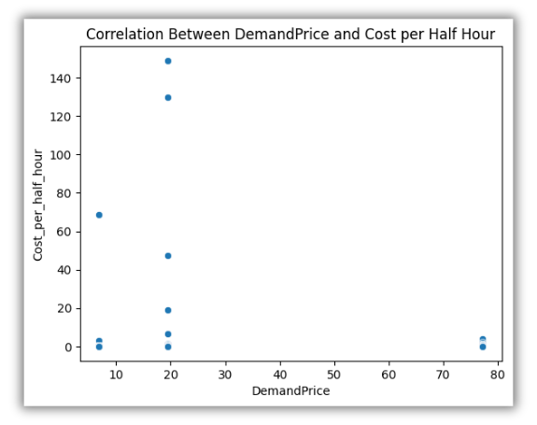

3. Data Normality and Homogeneity of Variance Checks and Cost Savings Analysis
24

Slide 27

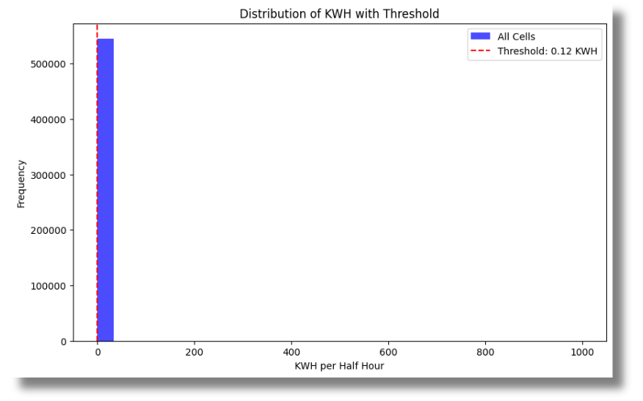


4. Threshold Determination
The determine_threshold function sets a threshold for energy consumption, currently defined as 50% of the mean. This threshold can be adjusted based on specific business requirements.
25

Slide 28

Factors driving energy consumption
Efficiency
Operational efficiency plays a significant role, with older equipment and outdated practices often resulting in higher energy consumption.
1
Weather
External factors like temperature, humidity, and wind can influence energy consumption, particularly for heating, cooling, and ventilation systems.
2
Industrial Activity
Industrial activity, such as manufacturing and data processing, often leads to significant energy consumption, particularly during peak hours.
3
Time of Day
Energy consumption patterns vary throughout the day, with peaks during peak hours and dips during off-peak hours.
4
26

Slide 29


THANK YOU
VERY MUCH

